Slide 1

Element of cost

Slide 2

Variable cost can be further classified into :
Direct material cost:
It is the cost of the raw materials and components used to create a product.
Direct labour cost:
It is the wages that are earned in order to produce specific goods or provide specific services to customers.
Direct expenses:
Expenses connected with purchases of goods are known as direct expenses. For example, freight, insurance of goods in transport, carriage, wages, import duty, etc.

Slide 3

Element of cost
Cost can be broadly classified into:
variable cost and
overhead cost.
Variable cost varies with the volume of production, while,
overhead cost is fixed, irrespective of the production volume.

Slide 4
The overhead cost can be classified into:
Factory overhead,
administration overhead,
selling overhead, and
Distribution overhead.

Slide 5
Factory overhead
Factory overhead include the depreciation or the rent on the factory building, depreciation on the factory equipment, supervisors in the factory, the factory quality control department, factory maintenance employees, electricity and gas for the factory, etc.

Slide 6
administrative overhead
These are the overheads incurred for the overall administrative work of the organization.
Such as office supplies, salaries payable to manager, clerk, legal/audit charges, etc.

Slide 7
Selling overheads
Selling expenses are incurred for promoting sales by convincing the customer to place an order with the firm.
These include the cost of printing and stationary, mailing literatures, catalogues, price lists, the salaries, commission etc.

Slide 8
Distribution overheads
Distribution expenses are incurred in moving the goods from company’s warehouse to customer’s place.
This includes the cost of packaging cases; oil, grease, spare parts used in maintenance of delivery vehicles.
Wages of packers, van drivers, dispatch clerks etc.
Warehouse expenses including rent, insurance, freight, carriage outwards and other transport charges, depreciation and running expenses of delivery vans.

Slide 9
OTHER COSTS/REVENUES
Marginal cost
Marginal revenue
Sunk cost
Opportunity cost

Slide 10
Marginal Cost
Marginal cost is defined as rate of change in total cost. It is change in TC due to one additional unit of output produced.
MC = Change in TC/Change in output
Marginal Revenue
Marginal revenue is defined as rate of change in total revenue. It is change in TR due to one additional unit of output sold.
MR = Change in TR/Change in output

Slide 11
Sunk Cost
This is known as the past cost of an equipment/asset.
Let us assume that an equipment has been purchased for Rs. 1,00,000 about three years back. If it is considered for replacement, then its present value is not Rs. 1,00,000. Instead, its present market value should be taken as the present value of the equipment for further analysis. So, the purchase value of the equipment in the past is known as its sunk cost. The sunk cost should not be considered for any analysis done from now onwards.

Slide 12
Opportunity Cost
Opportunity cost play important role in decision making. We go for the choice whose opportunity cost is minimum. It is the cost of best alternative foregone.
For example the opportunity cost of the government spending nearly 10 billion on investment in National Health Service might be that 10 billion less is available for spending on education or the transport network.

Slide 13
Breakeven Analysis
The main objective of break-even analysis is to find the cut-off production

Slide 14
What is Breakeven?
The Point at which Revenues = Costs
Revenues above the breakeven point result in profit
Revenues below the breakeven point result in loss
volume from where a firm will make profit. Let
s = selling price per unit
v = variable cost per unit
FC = fixed cost per period
Q = volume of production
Notes:
Introduction:
What is breakeven?
What is its purpose? Why should we learn it?

Slide 15
The Breakeven Equation
Revenue – Costs = Profit
Notes:
Activity Step 3 Identify the key variables in the breakeven equation.
The breakeven equation is based on the income statement equation: Revenues – Operating Costs = Profit

Slide 16
The Breakeven Equation
Revenue –Costs = Profit
Revenue - Variable Cost - Fixed Cost = Profit
Notes:
Activity Step 3 Identify the key variables in the breakeven equation. (cont’d)
Operating costs can be divided into two components: Variable and Fixed

Slide 17
The Breakeven Equation
Revenue –Costs = Profit
Revenue - Variable Cost - Fixed Cost = Profit
Breakeven Point is where Profit = 0
Revenue - Variable Cost - Fixed Cost = 0
Revenue = Variable Cost + Fixed Cost
Notes:
Activity Step 3 Identify the key variables in the breakeven equation. (cont’d)
Breakeven point is where profit equals zero, or Revenue – VC – FC = Profit.
Memorization is not emphasized in this course, but if you want to memorize a formula, this is the one to memorize. All breakeven formulas used in accounting textbooks are derived from this one equation.
Breakeven Point is where Profit = 0 or Revenue – VC – FC = 0
Another way of stating this is that Revenue = VC + FC

Slide 18
The Breakeven Equation
Revenue –Costs = Profit
Revenue - Variable Cost - Fixed Cost = Profit
Breakeven Point is where Profit = 0
Revenue - Variable Cost - Fixed Cost = 0
Revenue = Variable Cost + Fixed Cost
Revenue = #Units Sold * Selling Price $/Unit
Notes:
Activity Step 3 Identify the key variables in the breakeven equation. (cont’d)

Slide 19
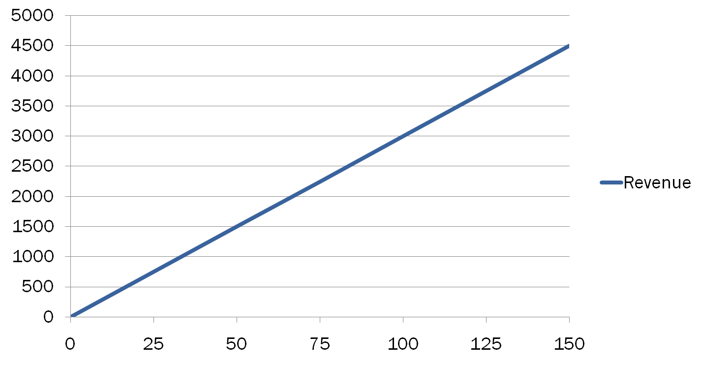
Graphic Depiction of Breakeven
$
Units Sold
Notes:
Activity Step 3 Identify key variables in the breakeven equation.
Identify the lines on the graph.
The purple line represents revenue. Revenue when zero units are sold is zero dollars.

Slide 20
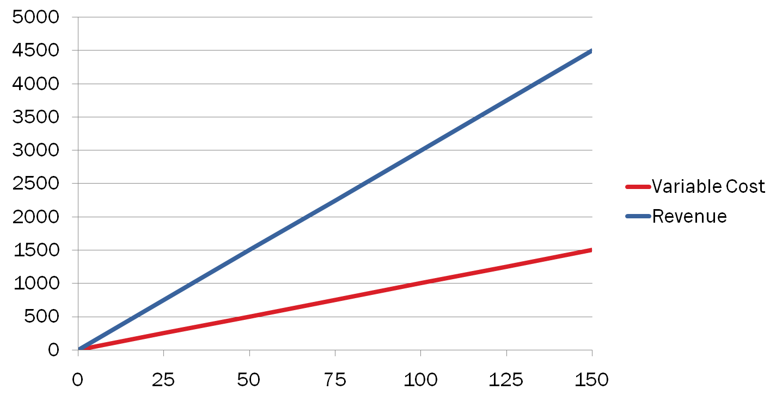
Graphic Depiction of Breakeven
$
Units Sold
Notes:
Activity Step 3 Identify key variables in the breakeven equation.
Identify the lines on the graph.
The red line represents variable cost. VC when zero units are sold is zero dollars.

Slide 21
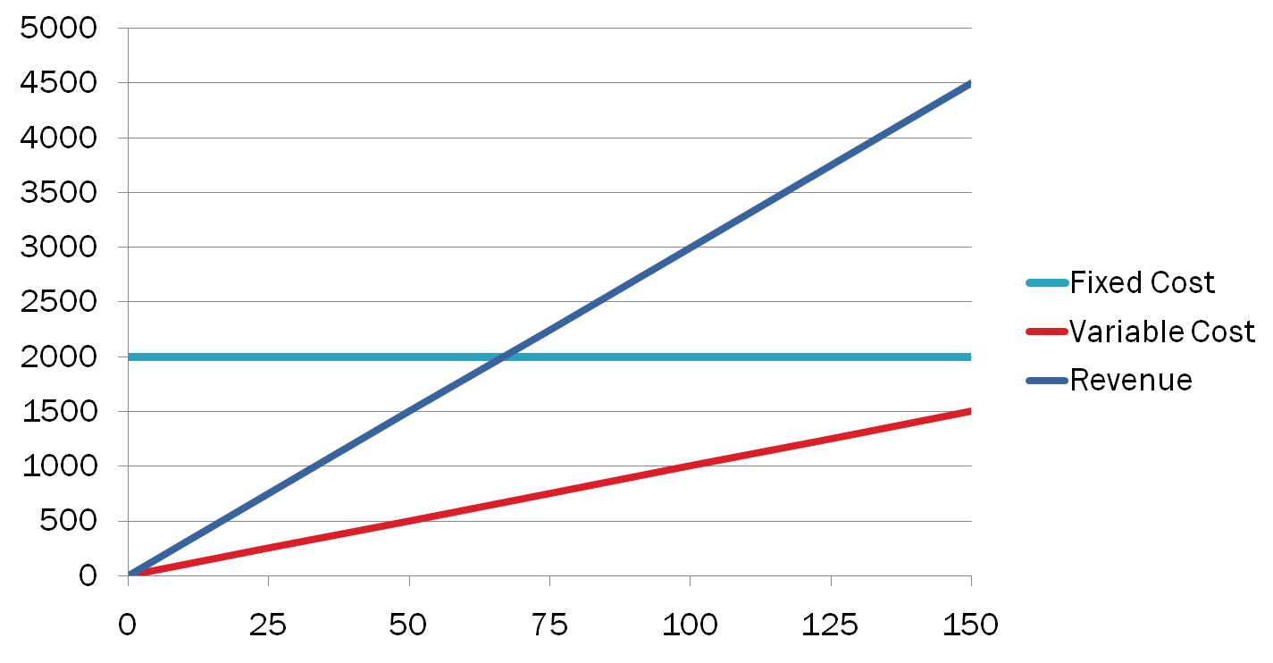
Graphic Depiction of Breakeven
$
Units Sold
Notes:
Activity Step 3 Identify key variables in the breakeven equation. (cont’d)
Identify the lines on the graph.
The blue line represents fixed cost. FC, by definition, remains the same regardless of number of units sold

Slide 22
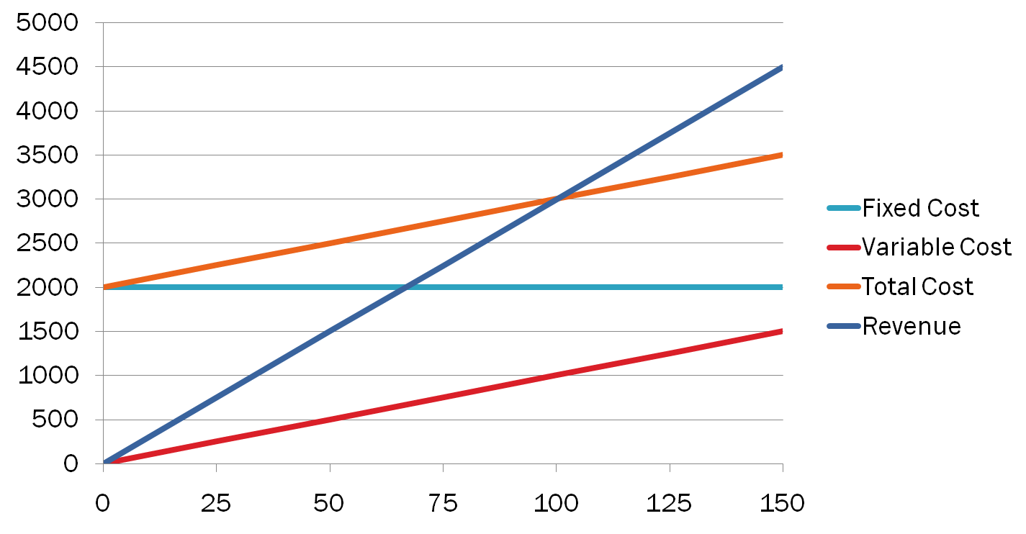
Graphic Depiction of Breakeven
$
Units Sold
Notes:
Activity Step 3 Identify key variables in the breakeven equation. (cont’d)
Identify the lines on the graph.
The green line represents total cost, which is the sum of VC and FC.

Slide 23
Graphic Depiction of Breakeven
$
Units Sold
Notes:
Activity Step 3 Identify key variables in the breakeven equation.
Identify the lines on the graph.
The Point at which Total Cost and Revenue intersect (are equal) is the point at which profit = zero

Slide 24
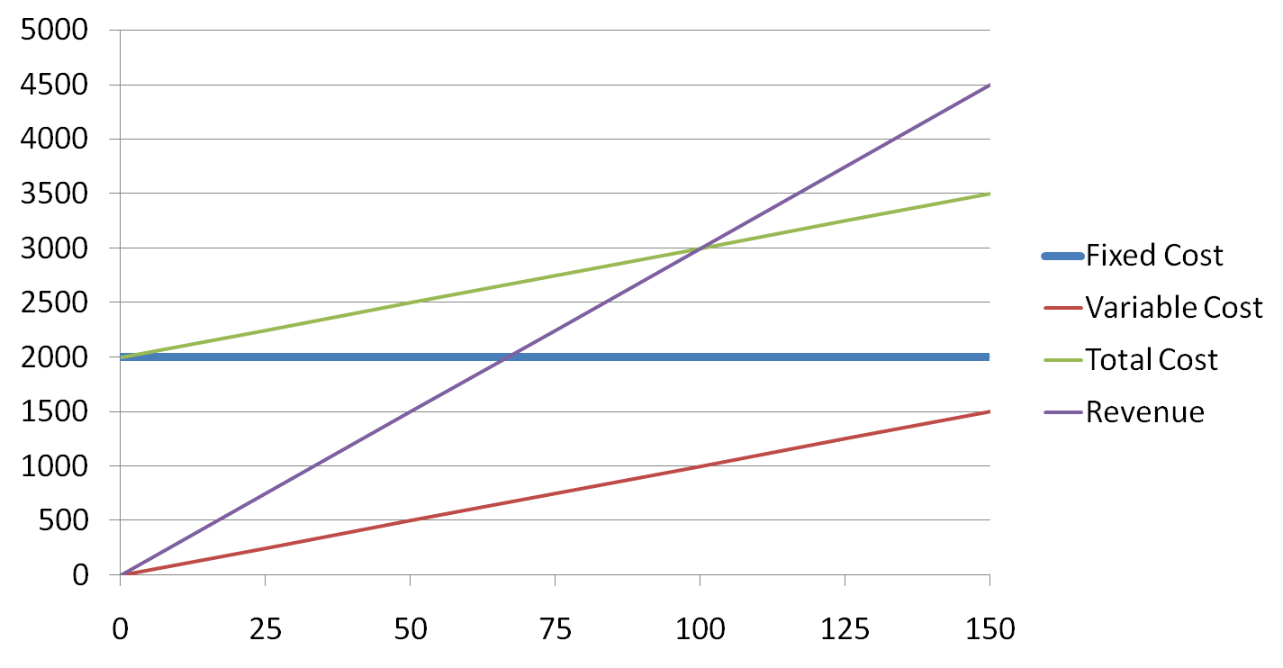
Graphic Depiction of Breakeven
$
Units Sold
Notes:
Activity Step 3 Identify key variables in the breakeven equation.
Identify the lines on the graph.
Revenue above the breakeven point results in profit (represented by the green shaded area)

Slide 25
Graphic Depiction of Breakeven
$
Units Sold
Notes:
Activity Step 3 Identify key variables in the breakeven equation.
Identify the lines on the graph.
Revenue below the breakeven point results in loss (represented by the red shaded area)

Slide 26
The total sales revenue (S) of the firm is given by the following formula:
S = s x Q
The total cost of the firm for a given production volume is given as
TC = Total variable cost + Fixed cost
TC= TVC+ TFC

Slide 27
For any production quantity which is more than the break-even quantity, the total revenue will be more than the total cost. Hence, the firm will be making profit.
Profit = Sales – (Fixed cost + Variable costs)
= s X Q – (FC + VC)

Slide 28
Example Find out the total cost and Sales of the firm and also find out the profit of the firm when the price of product is $45, and also describe it diagrammatically where break even point is equal to zero.
Total Output | Total Variable cost | Total Fixed cost
1.0 | 50 | 100
3.0 | 80 | 100
4.8 | 100 | 100
6.5 | 110 | 100
8.1 | 130 | 100
9.6 | 160 | 100
10.8 | 200 | 100
11.6 | 250 | 100
12.0 | 310 | 100
11.7 | 380 | 100

Slide 29
break-even quantity and break-even sales quantity
Break-even quantity refers to the number of units a Firm must sell to cover all its costs.
Break even sales a sales with no profit or loss, also called breakeven point. It is the sales volume, in units or in rupees, where total sales revenue equals total costs. Thus, zero profit results.

Slide 30
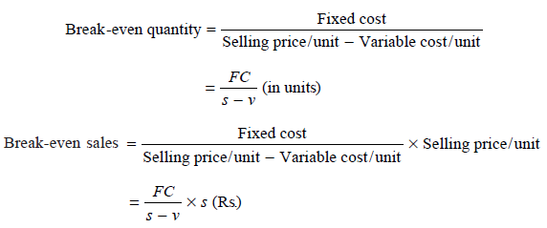
The formulae to find the break-even quantity and break-even sales quantity:

Slide 31
Contribution and margin of safety
The contribution is the difference between the sales and the variable costs. It is the amount of money a company has to cover its fixed costs after it pays all of its variable expenses
The margin of safety is how much output or sales level can fall before a business reaches its breakeven point. It is the sales over and above the break-even sales.

Slide 32
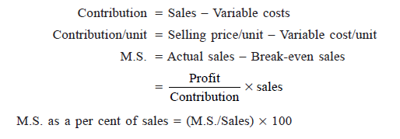
The formulae to compute these values are:

Slide 33
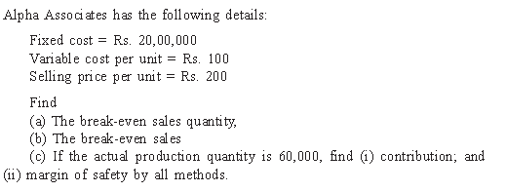
Example: 1

Slide 34
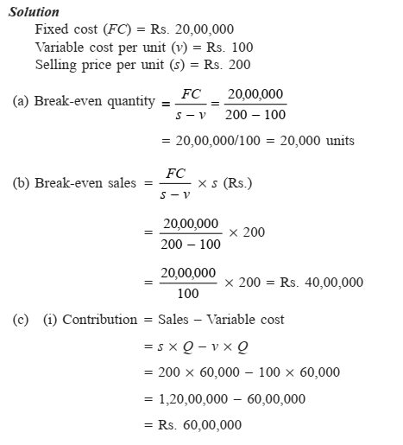

Slide 35
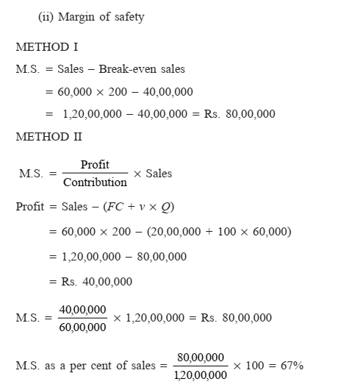

Slide 36
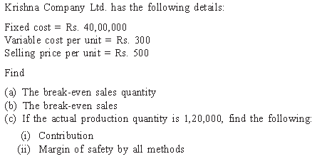
Example: 2

Slide 37
PROFIT/VOLUME RATIO (P/V RATIO)
P/V ratio is a valid ratio which is useful for further analysis. The ratio shows the amount of contribution per rupee of sales. Since, in the short-term, fixed cost does not change, the profit-volume ratio also measures the rate of change of profit due to change in the volume of sales.

Slide 38
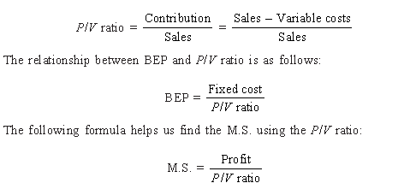
The different formulae for the P/V ratio are as follows:

Slide 39
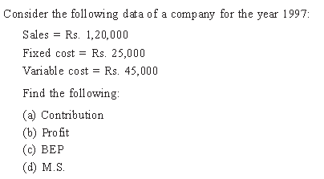
Example: 1

Slide 40
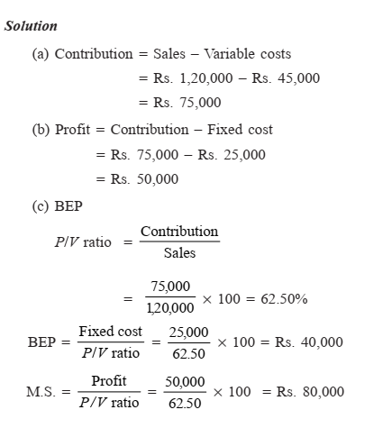

Slide 41
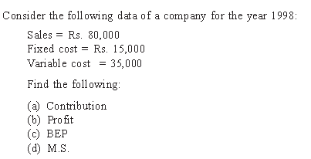
Example: 2

Slide 42
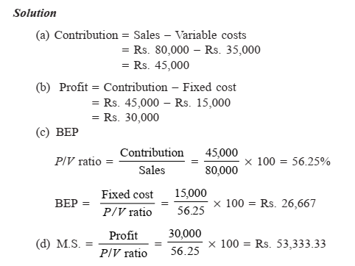

Slide 43
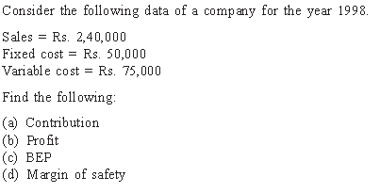
Example: 3

